Slide 1
Data Discretization
Machine Learning Algorithms & Programming
2026
Peter Waiganjo Wagacha

Slide 2
Data discretization Example1
Discretization the following Age data
Age | 10,11,13,14,17,19,30,31,32,38,40,42,70,72,73,75
What is the number of bins you propose?
What are the bin intervals?
What is the context/rationale behind the bins you have proposed?

Slide 3
Before Discretization Age:
10,11,13,14,17,19,30, 31, 32, 38, 40, 42,70 , 72, 73, 75
Based on a certain context, the possible 3 bins could be:
Young: 10,11,13,14,17,19
Mature: 30, 31, 32, 38, 40, 42
Old: 70 , 72, 73, 75
Q: What if our query data has an instance with age 60 or 25?

Slide 4
Data Discretization
Discretization is the process of putting values into buckets so that there are a limited number of possible states. The buckets themselves are treated as ordered and discrete values.
OR
Data discretization is characterized as a method of translating attribute values of continuous data into a finite set of intervals with minimal information loss.
We can discretize both numeric and string attributes.

Slide 5
Data Discretization
Discretization of the Top-down
If the procedure begins by first finding one or a few points to divide the whole set of attributes (called split points or cut points) and then performs this recursively at the resulting intervals, then it is called top-down discretization or slicing.
Discretization from the Bottom-up
If the procedure begins by considering all the continuous values as possible split-points, others are discarded by combining neighborhood values to form intervals, so it is called bottom-up discretization or merging.

Slide 6
Why Discretization is Important?
An infinite number of degrees of freedom (DoF) have mathematical problems with continuous data. For a variety of purposes, data scientists/data miners need the implementation of discretization.
Features Interpretation
Due to infinite degrees of freedom, continuous functions have a lower probability of correlating with the target variable and can have a complex non-linear interaction. Therefore, the understanding of such a function could be more complicated. Groups corresponding to the target may be viewed after discretizing a variable.
Ratio Signal-to-Noise
As we discretize a model, we fit it into bins and reduce the influence of minor data fluctuations. Sometimes, minor variations are known as noise. By discretization, we will reduce this noise. This is the "smoothing" method in which fluctuations are smoothed from each bin, thereby reducing noise in the results.

Slide 7
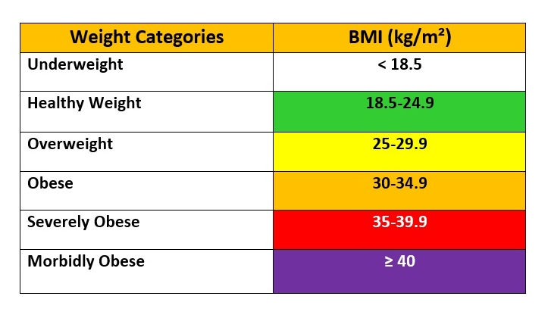
Data discretization Example 2
Body Mass Index (BMI) is a standard use to figure out a healthy weight for your height.
Generally, the higher the BMI, the more body fat a person has and vice versa.
BMI is often used as a screening tool to decide if your weight might be putting you at risk for health problems such as heart disease, diabetes, and cancer.

Slide 8
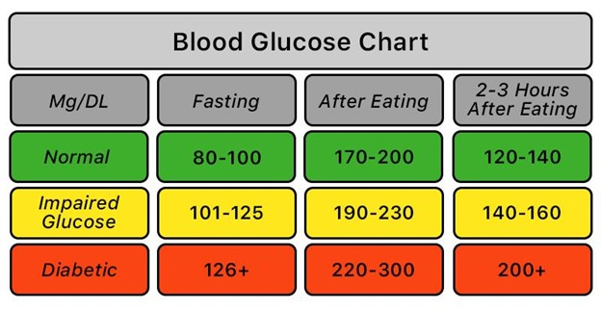
Data discretization Example 3
Blood Sugar/Glucose Testing for Diabetes
Fasting blood sugar test.
A blood sample will be taken after an overnight fast.
A fasting blood sugar level less than 100 mg/dL (5.6 mmol/L) is normal.
A fasting blood sugar level from 100 to 125 mg/dL (5.6 to 6.9 mmol/L) is considered prediabetes.
If it is 126 mg/dL (7 mmol/L) or higher on two separate tests, you have diabetes.
Source: https://www.medkart.in/blog/fasting-blood-sugar-normal-range

Slide 9
Data discretization Example 3
Blood Sugar/Glucose Testing for Diabetes
Oral glucose tolerance test.
For this test, you fast overnight, and the fasting blood sugar level is measured. Then you drink a sugary liquid, and blood sugar levels are tested periodically for the next two hours.
A blood sugar level less than 140 mg/dL (7.8 mmol/L) is normal.
A reading of more than 200 mg/dL (11.1 mmol/L) after two hours indicates diabetes.
A reading between 140 and 199 mg/dL (7.8 mmol/L and 11.0 mmol/L) indicates prediabetes.

Slide 10
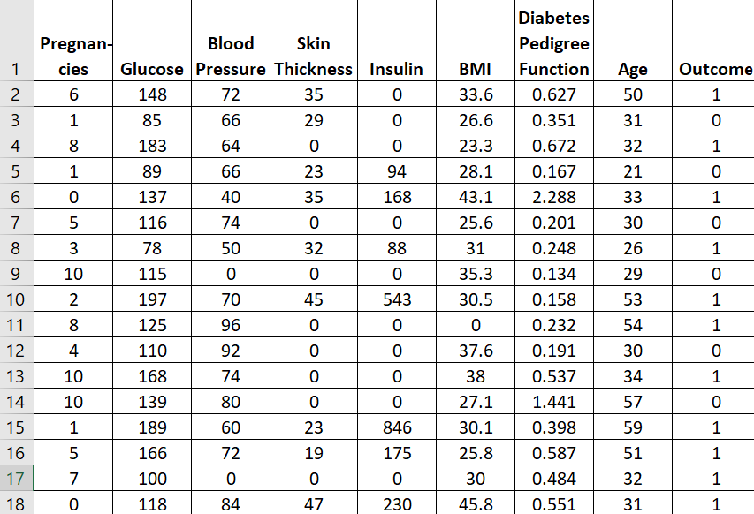
This sample diabetes clinic data can be processed using the categorization here, to bring in new meaning to the features.

Slide 11
Some Discretization methods
Domain Expert e.g. a specialist clinician
Histogram analysis
Binning
Correlation analysis
Clustering analysis
Decision tree analysis
Equal width partitioning
Equal depth partitioning

Slide 12
Sources
https://www.includehelp.com/basics/data-discretization-in-data-mining.aspx
https://www.nursesclass.com/2020/05/how-bmi-is-calculated-bmi-formula-bmi-ranges.html
https://towardsdatascience.com/an-introduction-to-discretization-in-data-science-55ef8c9775a2

